Slide 1
Capstone project
Unlocking Insights: A Comprehensive Analysis of ECommerce Sales of local store
SUBMITTED BY : SHALU KUMARI
BATCH : PGA 36 DATA SCIENCE AND ANALYTICS

Slide 2
Our analysis is structured around the following objectives:
Understanding Sales Trends: Identifying seasonal patterns and emerging trends in sales volumes and product categories.
Sales growth over the year : Identifying the change in sales in category over the year .
Total Sales and Revenue : Identifying the contribution of each category in Total Sales and Revenues of the year .
Each Category Performance : How each category had perform over the year and at the different Quarter with the Reviews.
Sales and Reviews Pattern : Where we look after for the correlation between the Sales of the Category and Review . .

Slide 3
Tools to be used in the Analysis :
Data source : Kaggle
MYSQL workbench :
Import Data , Clean, Make it easy to understand , Transform And Join table .
Power Bi :
Connect our data from MYSQL to Power bi , Import data , transform ,Make new columns , Use of Dax function ( New Measure / New column ) creation , Different visualization , Dash Board presentation .

Slide 4
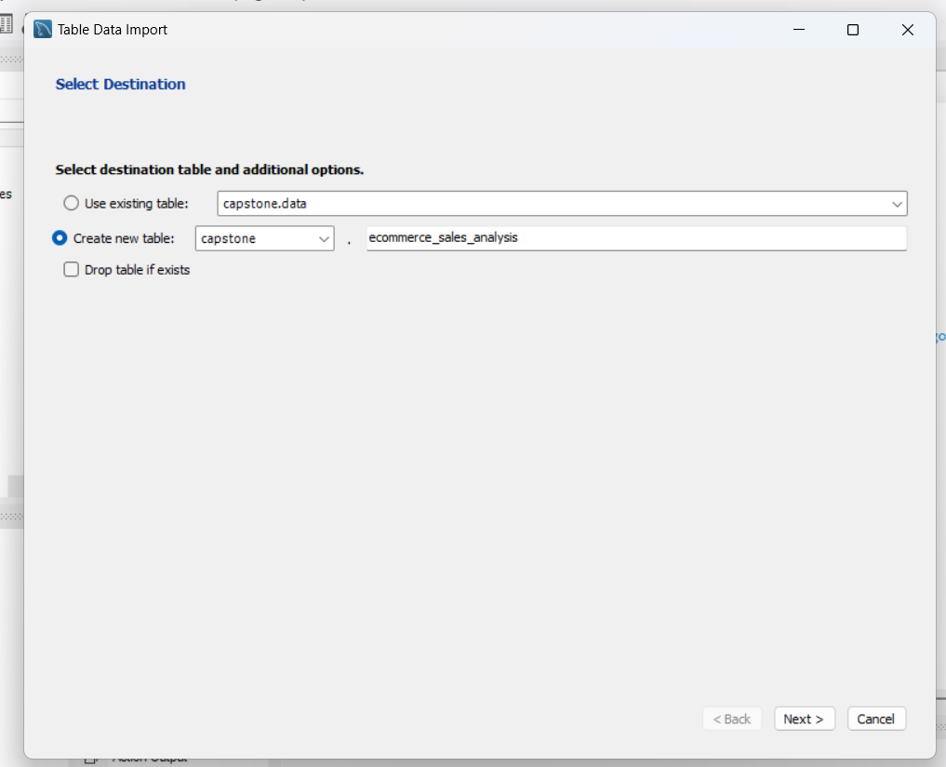
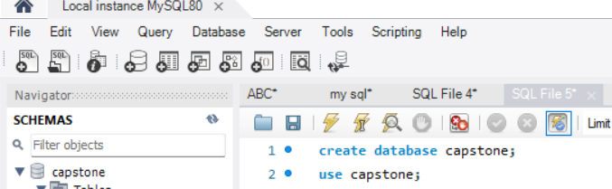
MYSQL
Creating a new Database of the name Capstone
Importing our tables :
Ecommerce sales table (where data for the product and sales of 1st 6 months are given ).
Last_6_month (where sales for last 6 month data is given ).

Slide 5
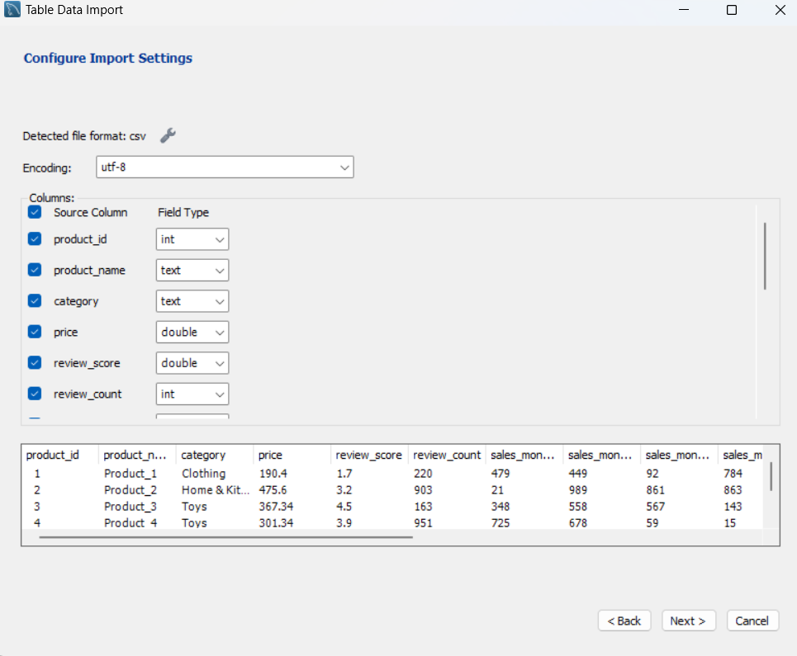
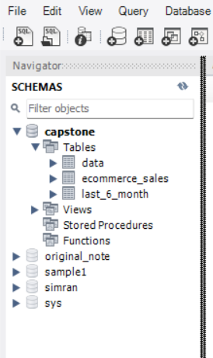

Slide 6
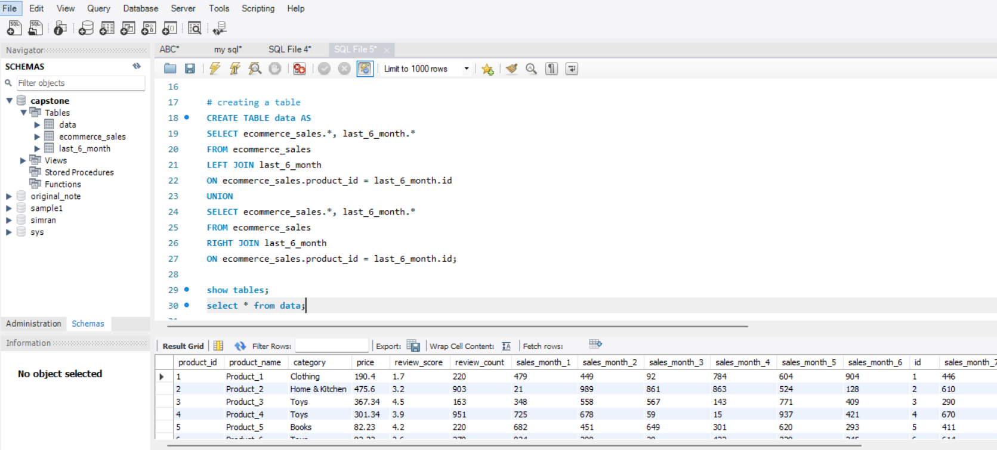
After Importing our data is divide into 2 different tables we merge the Table and form a new table name Data .

Slide 7
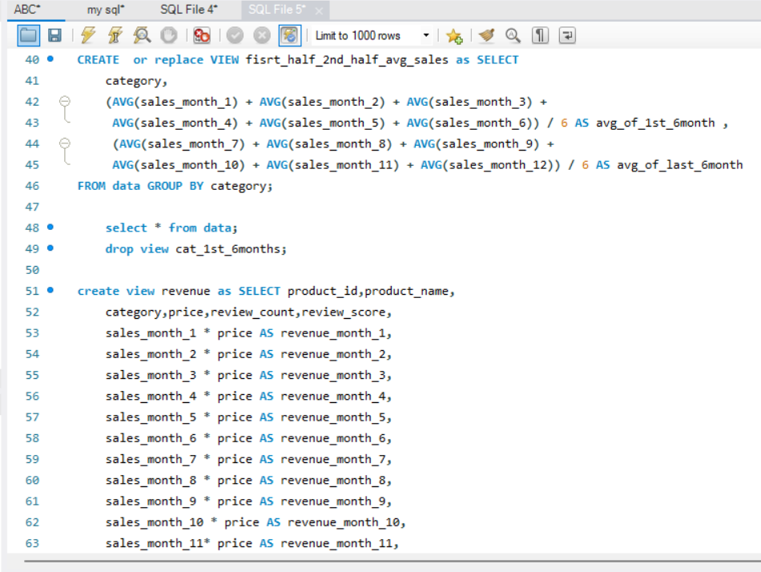
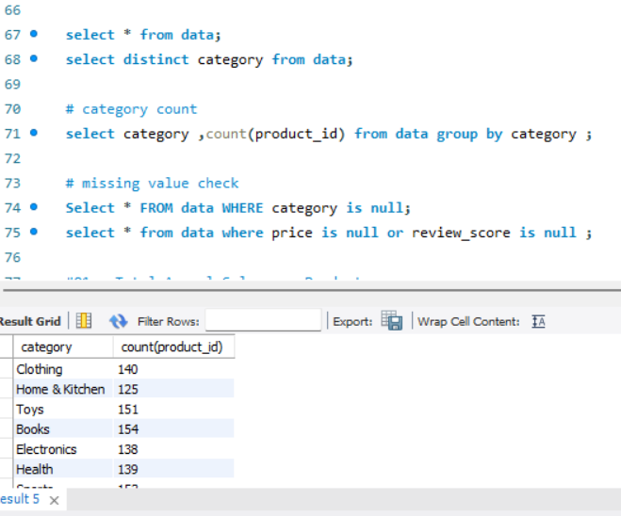
made some new columns using the already existing columns using the data table
Checked for missing values , category counts .

Slide 8
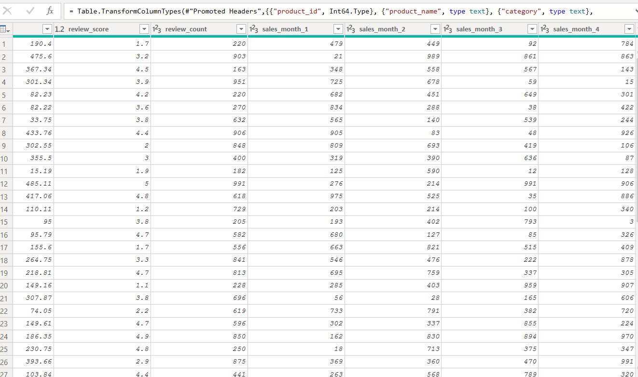
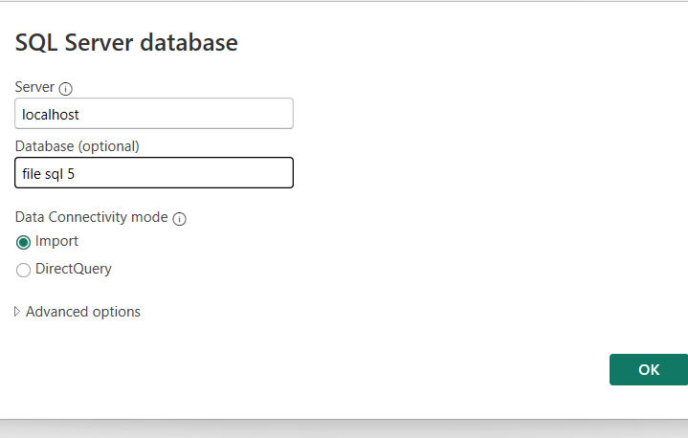
POWER BI
Import data from Mysql
Transform data

Slide 9
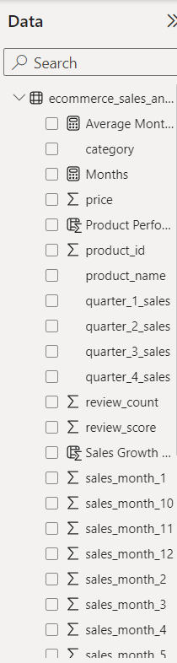
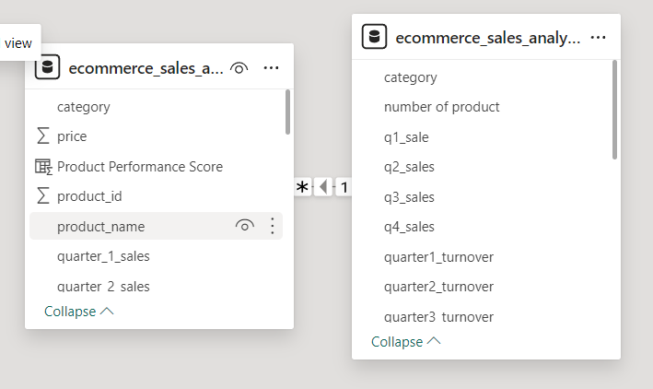
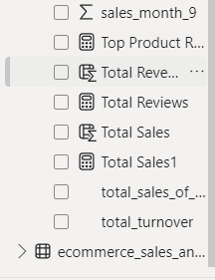
After transforming data made new measures , new Dax function and new columns and interactive Dashboards.
Entity Relationship

Slide 10
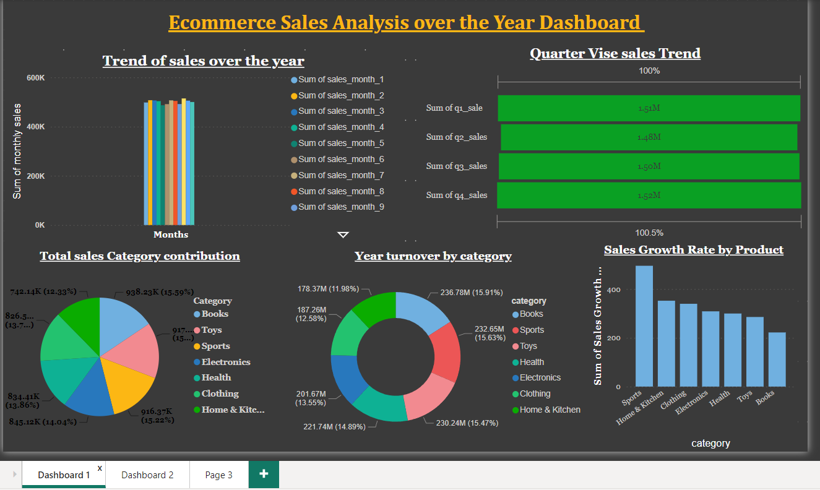

Slide 11
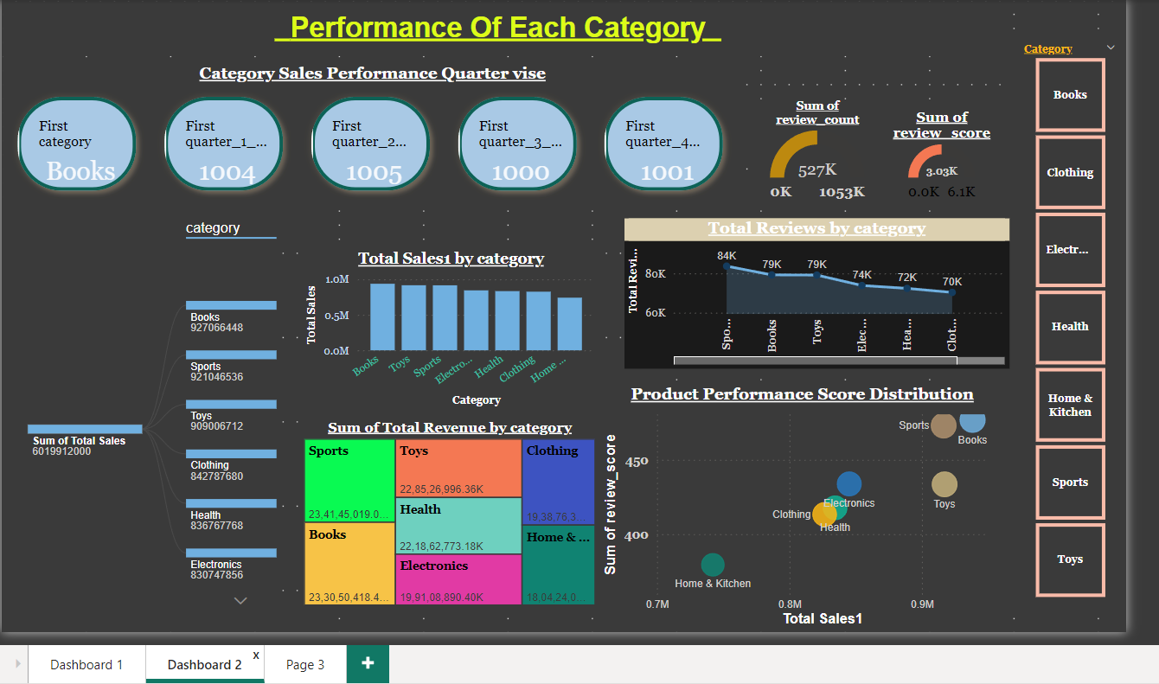

Slide 12
FINAL REPORT
ECOMMERCE SALES ANALYSIS OVER THE YEAR :
10TH Month have shown the highest sales over the year and least in 5th month of the year .
4th Quarter have highest sales and 2nd quarter have the least sales number .
Books and Toys have the highest sales over the year and least in home and kitchen.
Books ,sports and toys have the highest number of turnover over the year and home and kitchen have the least .
Sports category have shown the highest growth in the sales through out the year .

Slide 13

Thank you
SUBMITTED BY : SHALU KUMARI
BATCH : PGA-36

